Slide 1





Webinar: PFAS Testing Methods
September 1, 2020

Slide 2

Charting a Path to Solutions to PFAS in Food Service Ware & Packaging
What is “Charting a Path”?
Informal, multi-stakeholder group of manufacturers, retailers, health care organizations, governments, and NGOs
Platform for sharing information and having discussions on solutions to PFAS in food service ware and packaging
Topics covered
  PFAS test methods
  Purchasing recommendations for sustainable food service ware (led by Center for Environmental Health and Sustainable Purchasing Leadership Council)
  Roll out of Biodegradable Products Institute’s new standard for fluorinated chemicals, and City of San Francisco’s new Plastic, Toxics, and Litter Reduction ordinance.
For more info go to: https://www.bizngo.org/sustainable-materials/pfas-free-materials

Slide 3






Speakers & Charting a Path Leaders
James Ewell
Associate Director & Sustainable Chemistry Practice Lead, North America, Anthesis
Shari Franjevic,
GreenScreen Program Manager,
Clean Production Action
Erika Schreder
Science Director,
Toxic-Free Future
Jen Jackson
Toxics Reduction & Healthy Ecosystems Program Manager, San Francisco Department of the Environment
Mark S. Rossi, Ph.D.
Executive Director,
Clean Production Action
Sue Chiang, MPH, MPP
Pollution Prevention Director,
Center for Environmental Health

Slide 4
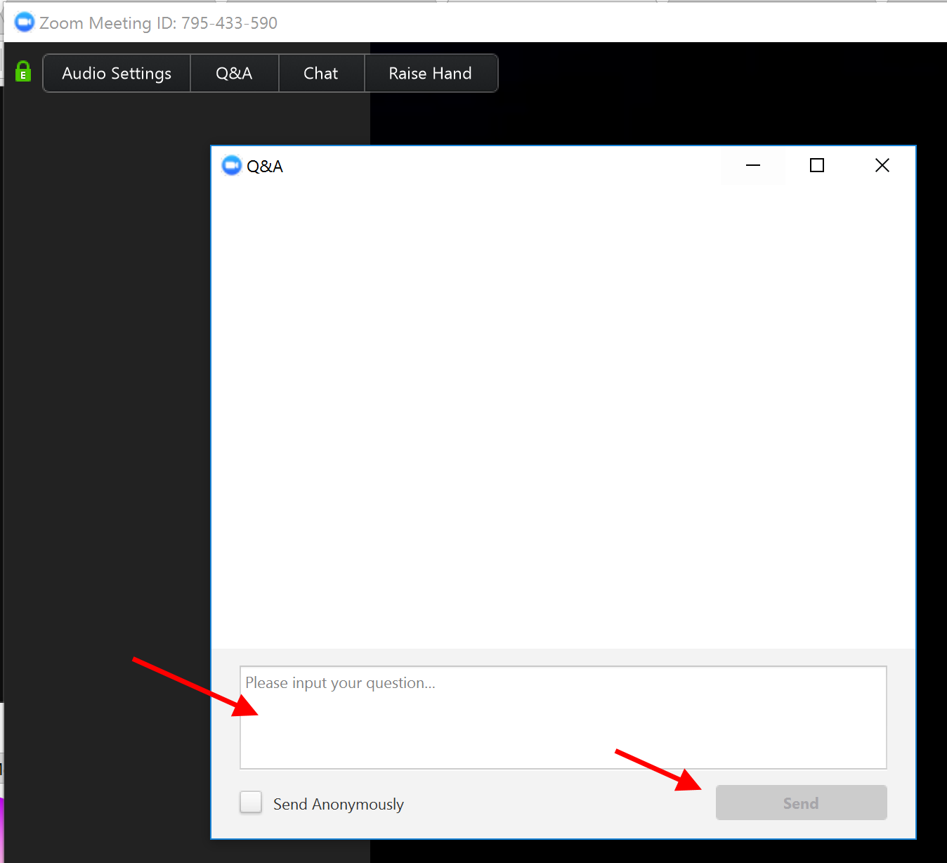
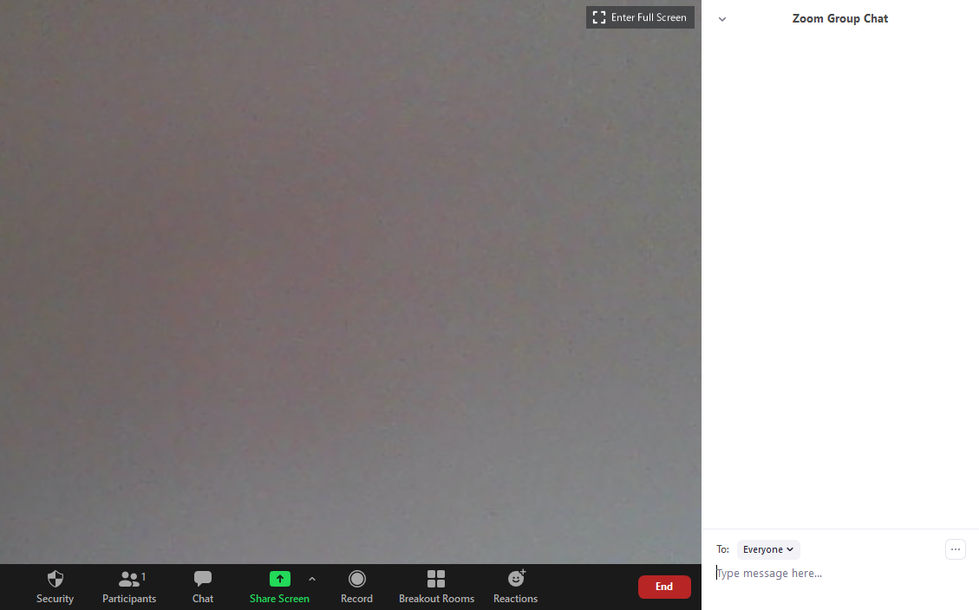
Zoom Logistics: Q&A & Chat

Slide 5
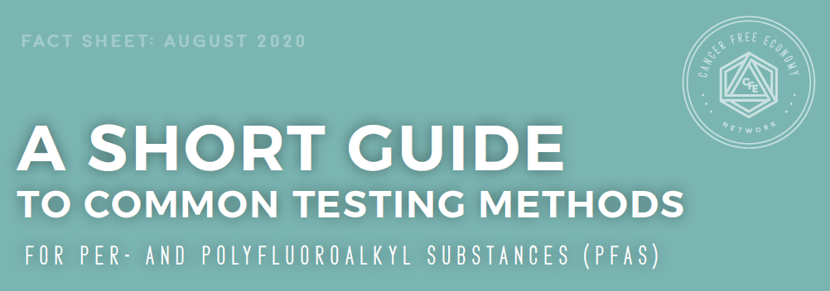
Access at: https://www.bizngo.org/sustainable-materials/pfas-free-materials

Slide 6

PFAS Test Methods
Shari Franjevic
GreenScreen Program Manager
Clean Production Action
September 1, 2020
Notes:
We are users of these analytical test results
We are not analytical chemists nor do we work with laboratories conducting these tests
We are serving as a clearinghouse for this information
We have learned through our own experience and put together this fact sheet as a reference for ourselves, then realized it could be helpful for others

Slide 7
PFAS Testing: Two Categories
What question are you trying to answer with your testing?
Total Fluorine Testing
    Efficient way to identify whether PFAS are likely present
    PFAS chemical class has > 5000 chemicals (analytes)
Targeted Testing
    Identify and quantify the presence of a specific set of PFAS
    Identify and quantify < 100 chemicals (analytes)
7
Notes:
Total Fluorine – affordable and good indicator that PFAS is in there

Slide 8
Total Fluorine Testing
Analytical Technique | Surface or Mass | Destructive | Commercially Available
Combustion ion chromatography (CIC) | Mass | Yes | Yes
Ion selective electrode (ISE) | Mass | Yes | Yes
X-ray photoelectron spectroscopy (XPS) | Surface | No | Yes
Particle-induced gamma emission (PIGE) | Surface | No | No
Instrumental neutron activation analysis (INNA) | Mass | No | No
8
Notes:
Very high level explanation of the analytical techniques used. Contact labs offering these methods to learn the details.
CIC: Combustion of the sample at high temperature to create HF and then HF absorption solution to make fluoride ions and ions measured by ion chromatography.
ISE: Combustion of the sample at high temperature and use fluorine specific electrode to measure ions.
XPS: A type of photoemission spectroscopy. X-ray beam is directed on sample (irradiate sample) and you measure kinetic energy and number of electrons ejected. Can be used to measure elements such as fluorine.
PIGE: A type of nuclear reaction analysis where a proton beam is directed onto a sample exciting nuclei so they emit gamma rays. These may be used to characterize the sample.
INNA: A type of nuclear reaction analysis using neutron activation. The sample is bombarded with neutrons, causing the elements to form radioactive isotopes. Study the spectra of radioactive emissions to well known emissions and decay paths for elements such as fluorine to determine concentration of the element within the sample.

Slide 9
Targeted Testing
Gas chromatography and mass spectrometry (GC/MS)
Liquid chromatography and mass spectrometry (LC/MS)
Quadrupole time-of-flight mass spectrometry (QTOF-MS) with GC or LC
Total Oxidizable Precurser (TOP) with GC/MS or LC/MS
9

Slide 10
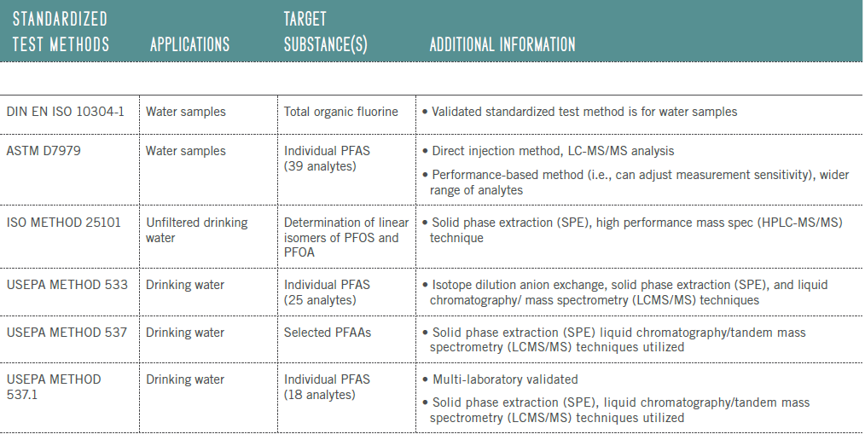
by liquid chromatography of ions
(2 analytes)
(14 analytes)
Notes:
ISO 10304-1:2007 specifies a method for the determination of dissolved bromide, chloride, fluoride, nitrate, nitrite, orthophosphate and sulfate in water, e.g. drinking water, ground water, surface water, waste water, leachates and marine water by liquid chromatography of ions.
ISO 25101:2009 specifies a method for the determination of the linear isomers of perfluorooctanesulfonate (PFOS) and perfluorooctanoate (PFOA) in unfiltered samples of drinking water, ground water and surface water (fresh water and sea water) using high-performance liquid chromatography-tandem mass spectrometry (HPLC‑MS/MS).
EPA Method 537 was published in 2009 for the determination of 14 PFAS in drinking water using solid phase extraction (SPE) and liquid chromatography/tandem mass spectrometry (LC/MS/MS).
EPA Method 537.1 Determination of Selected Per- and Polyflourinated Alkyl Substances in Drinking Water by Solid Phase Extraction and Liquid Chromatography/Tandem Mass Spectrometry (LC/MS/MS)

Slide 11
Other Considerations
Matrix
Type of PFAS chemicals
Extractable or total
Detection limit
11

Slide 12

GreenScreen Certified™ for Firefighting Foam
Avoid regrettable substitutes
Select preferred chemistry
Externally verified
12
Notes:
Demand for PFAS free firefighting foam
How do you avoid regrettable substitutes … select preferred chemistry and preferred products
RSL and GS tools important to avoid regrettable substitute
All chemicals disclosed under confidentiality
All chemicals assessed for hazard using GreenScreen tools
Product meets Restricted Substances List requirements
Product meets analytical testing requirements

Slide 13


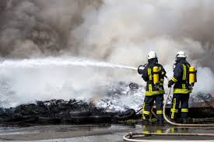
The story of selecting PFAS testing …
Notes:
Wanted total fluorine test (all PFAS)
Wanted a standardized mulit-lab validated test method – none available for total fluorine
Set threshold at 100 ppm based on what was being done in food service ware with BPI
Detection limit needed to be < 100 ppm
Started with PIGE method for pilot, can be used with our matrix, inexpensive and fast, met our detection limit
Peer review feedback – need much lower threshold, use a method available from a commercial lab
CIC used in Australia on firefighting foam
Talk to a few labs
Set threshold – combination of what we wanted and what was possible with the testing, would have gone lower if we could have achieved it
Method development with the lab to reach the threshold, didn’t know if they could achieve it – experience with PFAS containing foams but not FFF
Working through interferences, work with manufacturers about what other chemistry might be in the products
Worked through dilution process for getting to required detection limit
Learning process ... as we do the testing and companies go through we learn what they can meet and iterate

Slide 14
Total Organic Fluorine for Firefighting Foam
Measured on the product as sold (i.e., concentrate)
Samples: Test samples from three different lots or batches
Requirement: < 1 mg/kg (< 1 ppm) total organic fluorine
Laboratory: international commercial laboratory
Analytical technique: combustion ion chromatography
Notes:
3rd party

Slide 15
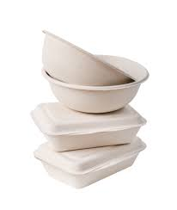
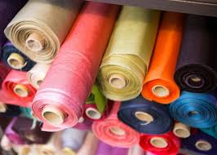
The story of selecting PFAS testing …
Notes:
Currently working on defining testing requirements for other product categories
Assumed we could use the same lab and same analytical technique
Learned differently …
Conversations with several labs
Different considerations e.g., matrix, type of PFAS expected
Textiles - different chemicals in there e.g., side chain fluorotelomers used in fabrics, become part of polymer and cannot be extracted
Food Service Ware precedent with ISE and threshold established – opportunity to harmonize to reduce duplicate testing

Slide 16
Thank you!
Contact Clean Production Action:
Shari Franjevic
GreenScreen Program Manager
shari@cleanproduction.org
781-391-6743x117
https://www.greenscreenchemicals.org/
16

Slide 17
When to Test:
Guidance for Retailers and Restaurants
September 1, 2020
Erika Schreder
Toxic-Free Future
eschreder@toxicfreefuture.org

Slide 18
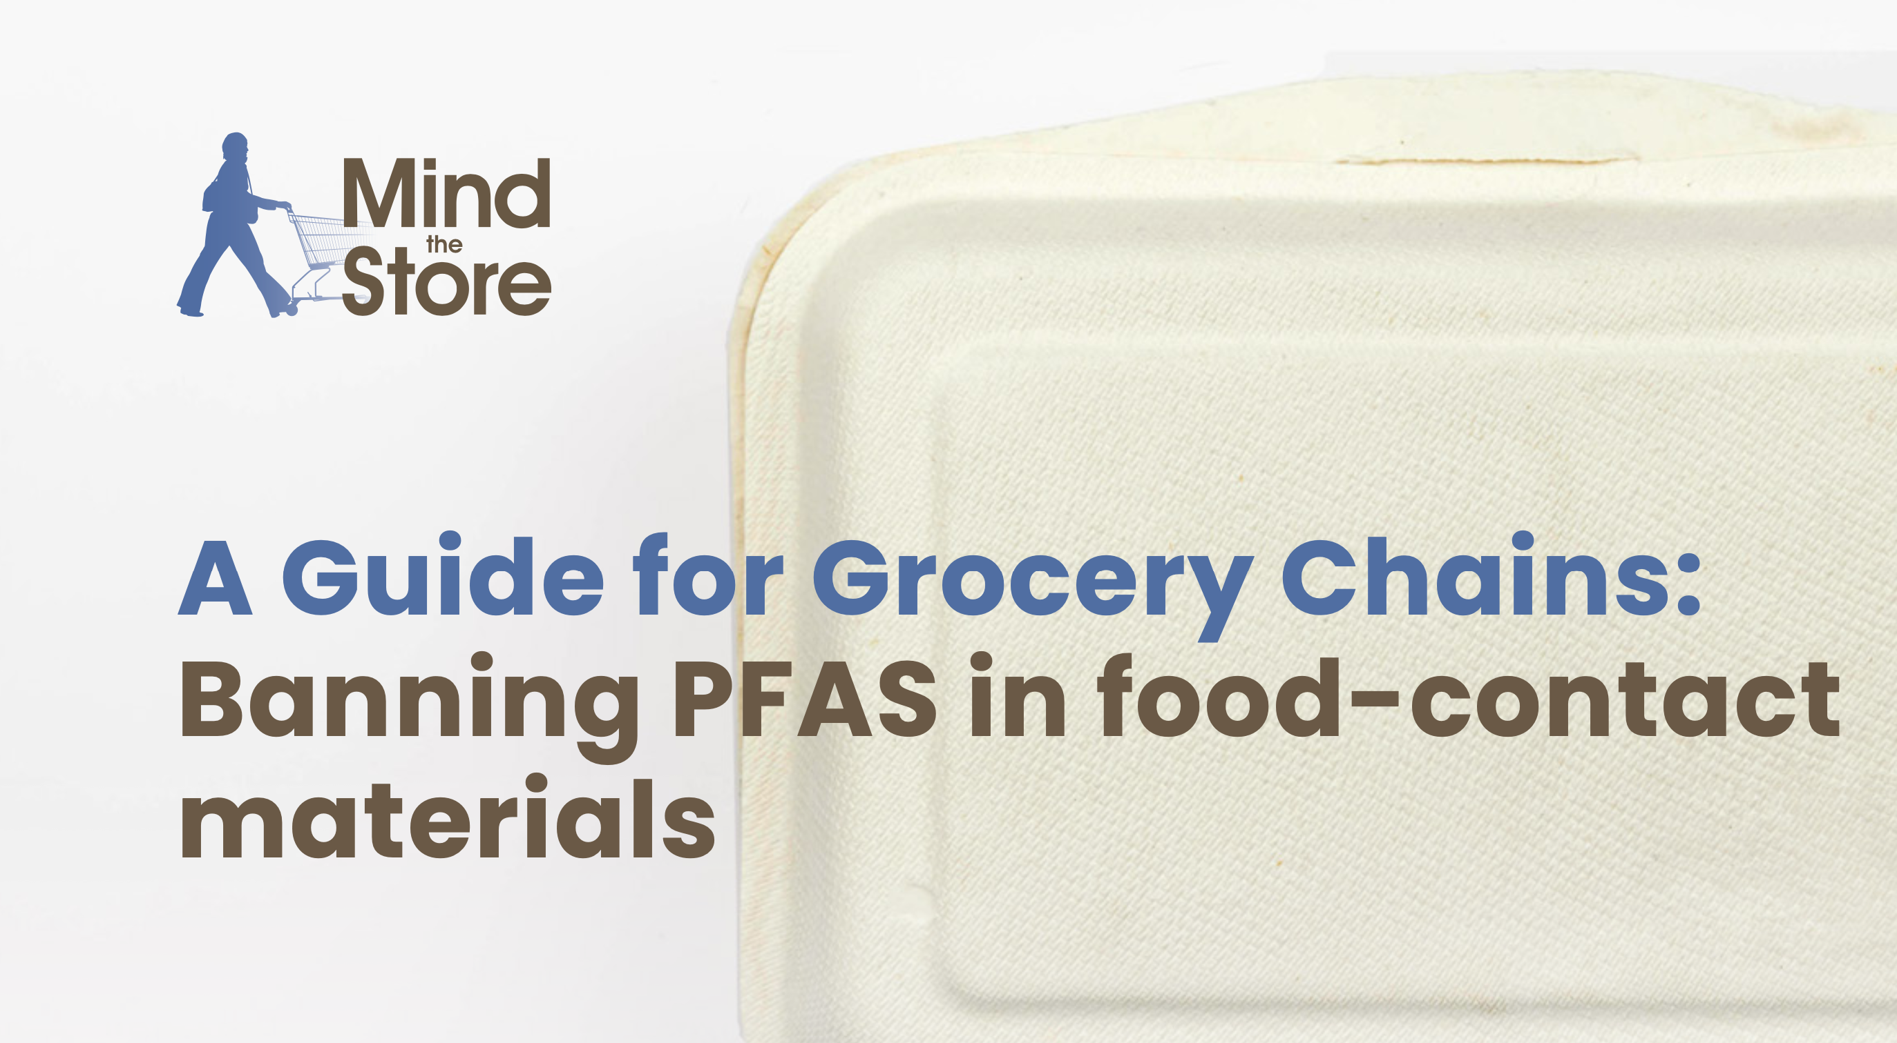

Slide 19
Retailers in the Lead
Sweetgreen, Chipotle phasing out by end of 2020
Ahold Delhaize policy announced in 2019, pledged to expand supplier testing requirements in 2020

Slide 20
Step 1: Strong Policy
Clear, quantifiable goals for phaseout of PFAS
Timelines for phaseout
Plan to clearly communicate to suppliers and address PFAS in materials

Slide 21
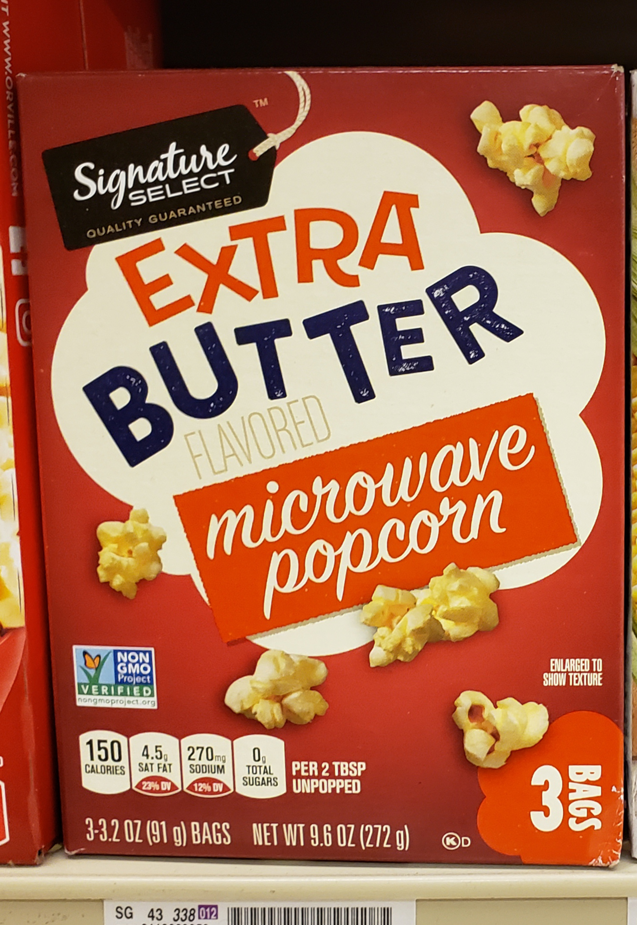
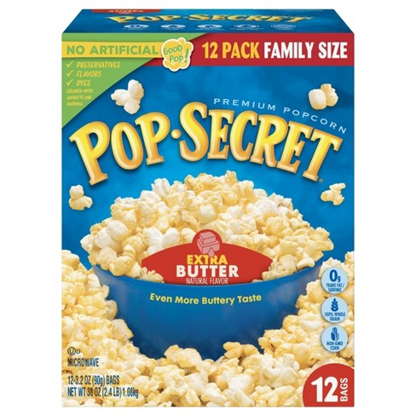
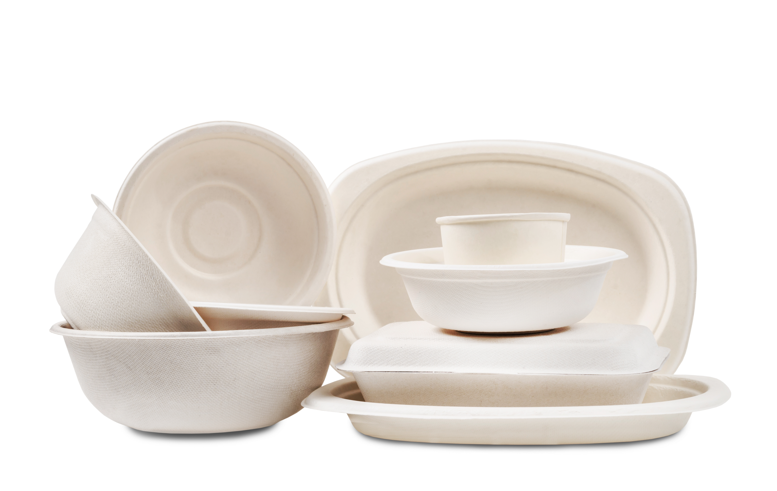
Priorities for Addressing PFAS
1. Materials for food served in-store
2. Materials for private-label food
3. Materials for brand-name food

Slide 22
Step 2: Get Info From Suppliers
Require suppliers to attest that materials are PFAS-free
Require suppliers to submit total fluorine test results
Annual testing to guard against changes

Slide 23
Step 3: Verification Testing
Retailers should do their own testing of priority products

Slide 24
Step 4: Review Total F Results
F detected?
Intentionally added for grease/water resistance?
Intentionally added for another reason?
List of materials and additives
Work with suppliers to get at source of fluorine
Chemicals used in manufacturing may be source
Contamination?

Slide 25
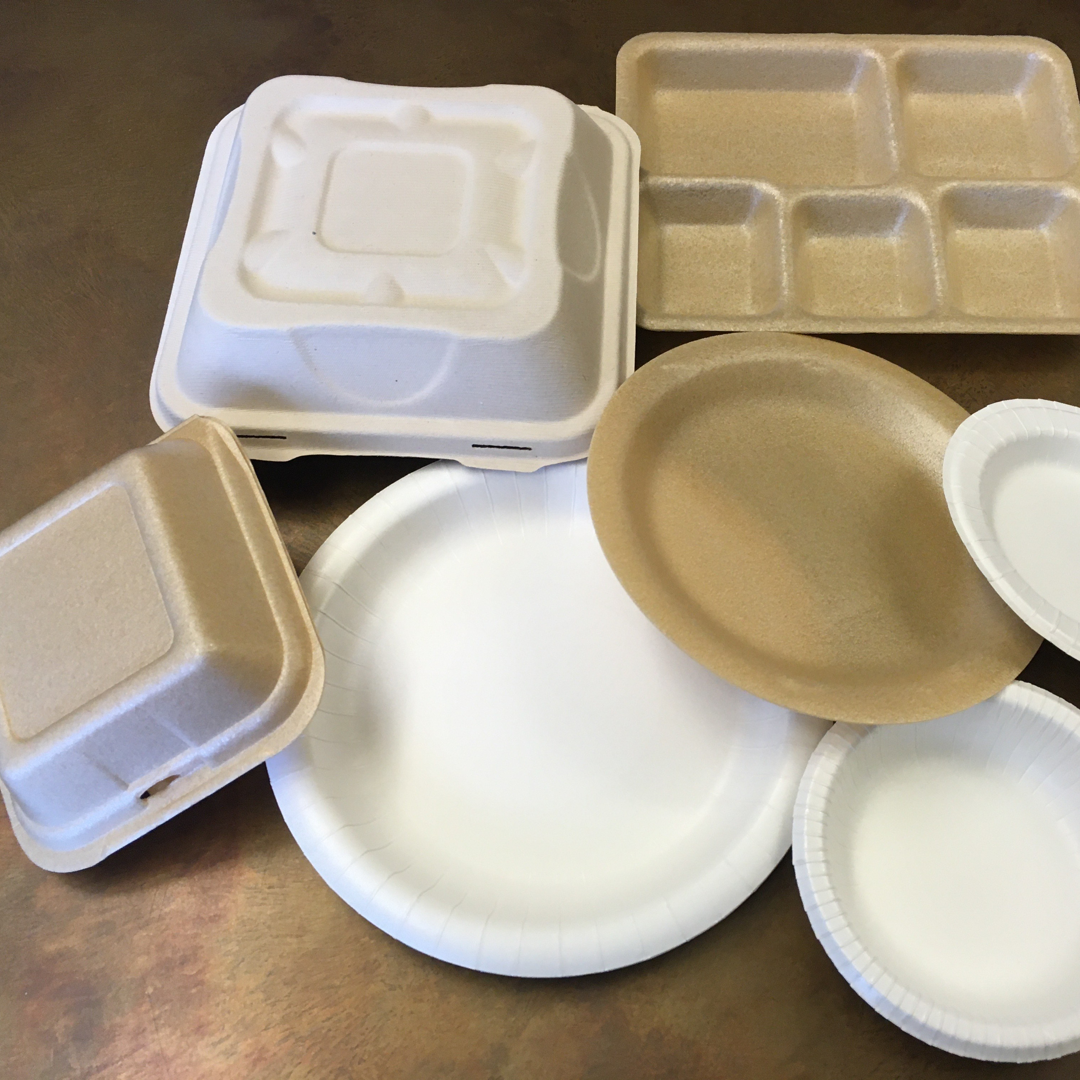
Step 5: Safe Substitution
PFAS-containing materials should be replaced with a safer alternative or redesigned
Suppliers should conduct hazard assessments of alternatives with GreenScreen

Slide 26
Supplier requirements need to be part of specifications and contracts
Step 6: Add to Contract
Each year, report publicly on progress and challenges
Step 7: Maintain Transparency

Slide 27


Slide 28
For recordings and slides visit: https://www.bizngo.org/resources/entry/charting-a-path

